Slide 1
Chapter 5
Internet Backbones Networks
Optical Backbone, Marine Cables, Teleports, Satellite and Terrestrial Links

Slide 2
Optical Backbone
Optical network technology offers the possibility of increasing the core network rates by several order of magnitude (~4) and at the same time decreases the cost per bit by approximately the same amount
An optical fiber is a flexible, transparent fiber made of extruded glass (silica) or plastic, slightly thicker than a human hair. It can function as a waveguide, or “light pipe”, to transmit light between the two ends of the fiber
Optical fibers typically include transparent core surrounded by a transparent cladding material with a lower index of refraction. Light is kept in the core by total internal reflection. This causes the fiber to act as a waveguide.

Slide 3
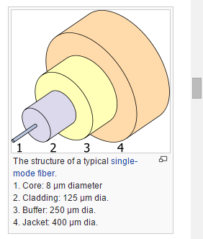
Structure of optical fiber
If you look closely at a single optical fiber, you will see that it has the following parts:
Core - Thin glass center of the fiber where the light travels
Cladding - Outer optical material surrounding the core that reflects the light back into the core
Buffer coating - Plastic coating that protects the fiber from damage and moisture
jacket - Hundreds or thousands of these optical fibers are arranged in bundles in optical cables. The bundles are protected by the cable's outer covering, called a jacket

Slide 4
Optical fibers come in two types
Single-mode fibers have small cores (about 3.5 x 10-4 inches or 9 microns in diameter) and transmit infrared laser light (wavelength = 1,300 to 1,550 nanometers).
Multi-mode fibers have larger cores (about 2.5 x 10-3 inches or 62.5 microns in diameter) and transmit infrared light (wavelength = 850 to 1,300 nm) from light-emitting diodes (LEDs).

Slide 5
Bandwidth and Modulation used
Wavelength-division multiplexing (WDM) is the practice of multiplying the available capacity of optical fibers through use of parallel channels, each channel on a dedicated wavelength of light.
This requires a wavelength division multiplexer in the transmitting equipment and a demultiplexer in the receiving equipment.
Arrayed waveguide gratings are commonly used for multiplexing and demultiplexing in WDM.
Using WDM technology now commercially available, the bandwidth of a fiber can be divided into as many as 160 channels to support a combined bit rate in the range of 1.6 Tbit/s

Slide 6
Band width
Optical Carrier 1= 51.85 Mbps
Optical Carrier 3= 155.52 Mbps
Optical Carrier 12=622.08 Mbps
Optical Carrier 24= 1.244 Gbps
Optical Carrier 48= 2.488 Gbps
Optical Carrier 192= 9.952 Gbps
Optical Carrier 255= 13.21 Gbps

Slide 7
Advantage of optical fiber
Bandwidth: Fiber optic cables have a much greater bandwidth than metal cables. This means that they can carry more data.
Electromagnetic Interference : Fiber optic cables are less susceptible than metal cables to interference.
Installation: Fiber optic cables are much thinner and lighter than metal wires and are easy to install
Digital signals: Data can be transmitted digitally (the natural form for computer data) rather than analogically
Data Security: There are no radiated magnetic fields around optical fibers; the electromagnetic fields are confined within the fiber. That makes it impossible to tap the signal being transmitted through a fiber without cutting into the fiber

Slide 8
Disadvantage
Limited physical arc of cable. Bend it too much and it will break.
Difficult to splice.
Physical vibration will show up as signal noise.
Loss of light in fiber due to scattering. (Attenuation)
Transmission on optical fiber requires repeating at distance intervals
Cables are expensive to install but last longer than copper cables

Slide 9
Marine Cables
A submarine communications cable is a cable laid on the sea bed between land--‐based stations to carry telecommunication signals across stretches of ocean.
The first submarine communications cables, laid in the 1850s, carried telegraphy traffic.
Subsequent generations of cables carried telephone traffic, then data communications traffic.
Modern cables use optical fiber technology to carry digital data, which includes telephone, Internet and private data traffic.

Slide 10
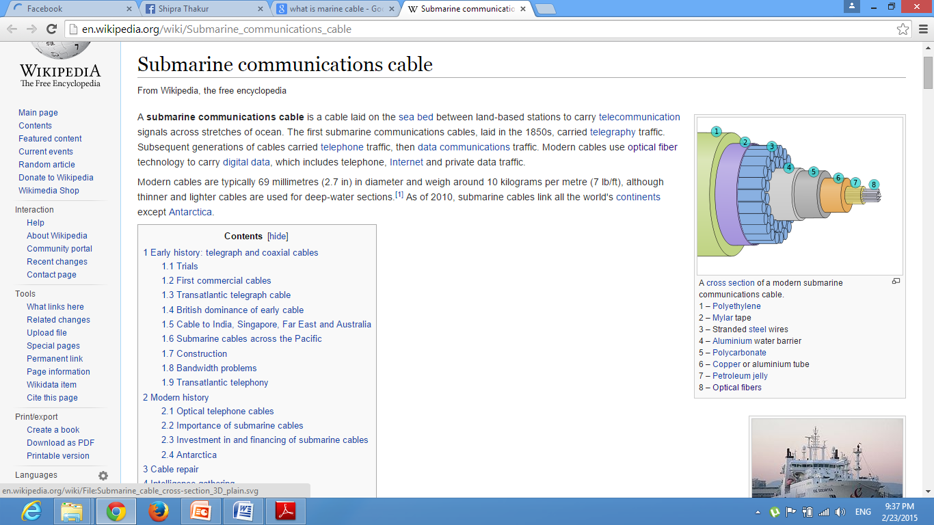
Modern cables are typically 69 millimetres (2.7 in) in diameter and weigh around 10 kilograms per metre although thinner and lighter cables are used for deep-water sections

Slide 11
Importance of submarine cables
As of 2006, overseas satellite links accounted for only 1 percent of international traffic, while the remainder was carried by undersea cable.
The reliability of submarine cables is high, especially multiple paths are available in the event of a cable break.
the total carrying capacity of submarine cables is in the terabits per second, while satellites typically offer only 1000 megabits per second and display higher latency.
However, a typical multi-terabit, transoceanic submarine cable system costs several hundred million dollars to construct.
As a result of these cables' cost and usefulness, they are highly valued not only by the corporations building and operating them for profit, but also by national governments.

Slide 12
Teleport
A telecommunications port—or, more commonly, teleport—is a satellite ground station that functions as a hub connecting a satellite or geocentric orbital network with a terrestrial telecommunications network, such as the Internet
a centre providing interconnections between different forms of telecommunications, especially one which links satellites to ground-based communications
A planned business development area that features direct and economic access to a large number of domestic and international satellites for users in the surrounding region, with the aid of a regional distribution network
Teleports may provide various broadcasting services among other telecommunications functions, such as uploading computer programs or issuing commands over an uplink to a satellite

Slide 13
Satellite and Terrestrial Links
Satellite is an artificial object, which has been intentionally placed into orbit, Such objects are sometimes called artificial satellites
Satellites are used for a large number of purposes. Common types include military and civilian Earth observation satellites, communications satellites, navigation satellites, weather satellites, and research satellites
Satellite communication is the branch of telecommunication which establishes and communication using satellites across the globe.
We can divide the whole satellite communication into two parts namely space segments and earth segments.
Satellite communication uses highly sophisticated and secured communication methods

Slide 14
Type of Satellite
Low-Earth orbits (LEO) — LEO satellites occupy a region of space from about 111 miles (180 kilometers) to 1,243 miles (2,000 kilometers) above Earth. Satellites moving close to the Earth‘s surface are ideal for making observations, for military purposes and for collecting weather data
Medium-Earth orbits (MEO) — These satellites park in between the low and high flyers, so from about 1,243 miles (2,000 kilometers) to 22,223 miles (36,000 kilometers). Navigation satellites, like the kind used by your car's GPS, work well at this altitude. Sample specs for such a satellite might be an altitude of miles (20,200 kilometers) and an orbital speed of 8,637 mph (13,900 kph).
Geosynchronous orbits (GEO) — GEO satellites, also known as geostationary satellites, move around Earth at an altitude greater than 22,223 miles (36,000 kilometers) and at the same speed of rotation. As a result, satellites in these orbits are always positioned over the same spot on Earth. Many geostationary satellites fly above a band along the equator, which has led to significant congestion in this region of space. Several hundred television, communications and weather satellites all use geostationary orbits.

Slide 15
Structure
Communications Satellites are usually composed of the following subsystems:
Communication Payload, normally composed of transponders, antennas, and switching systems
Engines used to bring the satellite to its desired orbit
Station Keeping Tracking and stabilization subsystem used to keep the satellite in the right orbit, with its antennas pointed in the right direction, and its power system pointed towards the sun
Power subsystem, used to power the Satellite systems, normally composed of solar cells, and batteries that maintain power during solar eclipse
Command and Control subsystem, which maintains communications with ground control stations. The ground control earth stations monitor the satellite performance and control its functionality during various phases of its life-cycle.
The bandwidth available from a satellite depends upon the number of transponders provided by the satellite. Each service (TV, Voice, Internet, radio) requires a different amount of bandwidth for transmission. This is typically known as link budgeting and a network simulator can be used to arrive at the exact value

Slide 16
Frequency Allocation for satellite systems
Allocating frequencies to satellite services is a complicated process which requires international coordination and planning.
This is carried out under the auspices of the International Telecommunication Union (ITU).
To facilitate frequency planning, the world is divided into three regions:
Region 1: Europe, Africa, what was formerly the Soviet Union, and Mongolia
Region 2: North and South America and Greenland
Region 3: Asia (excluding region 1 areas), Australia, and the southwest Pacific

Slide 17
services provided by satellites
Fixed satellite service (FSS)
fixed service satellite is a type of satellite used for services such as telephone calls, and television signals for broadcasting. Fixed service satellite generally have a low power output and larger dish-style antennas are required for reception
Broadcasting satellite service (BSS)
The type of satellite television which uses direct-broadcast satellites is known as direct-broadcast satellite television (DBSTV) or direct-to-home television (DTHTV)
Mobile satellite services
Navigational satellite services
Meteorological satellite services

